Slide 1

Project 4 Group 3 Mitchell Lor Waynei Mebrahtu Eric Johnson Lucinda Hodgson
Predicting Corporate Credit Ratings
GitHub: https://github.com/ericjjohnson2/corporate_credit_rating

Slide 2
Corporate Credit Ratings:
-issued by credit rating agencies
-provide assessment of creditworthiness
-can indicate if a corporation will fully meet its financial obligations
Why Ratings are Important:
-quick assessment of financial performance
Why there are Limitations:
-assessments are not infallible
*i.e., mortgage back securities receiving AAA ratings in 2008

Slide 3
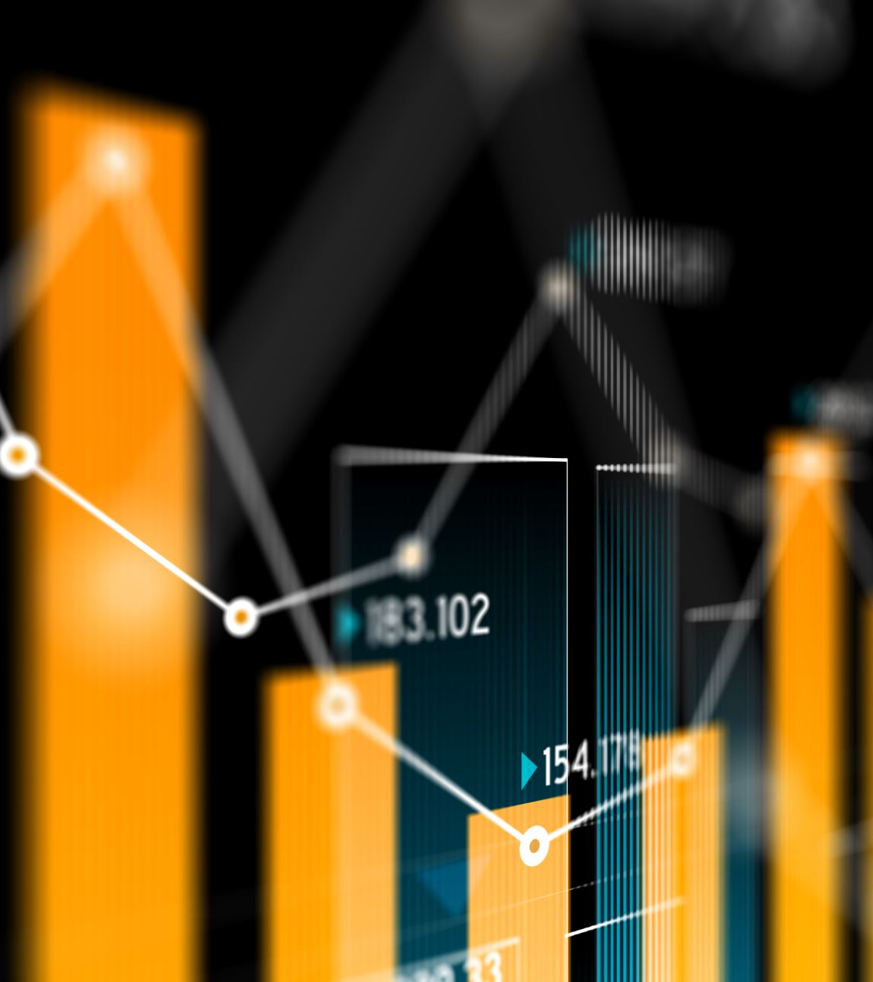
About the data
Source: Kaggle
1377 unique corporations
7805 Rows
24 columns
First 9 are categorical
Next 15 are numeric

Slide 4
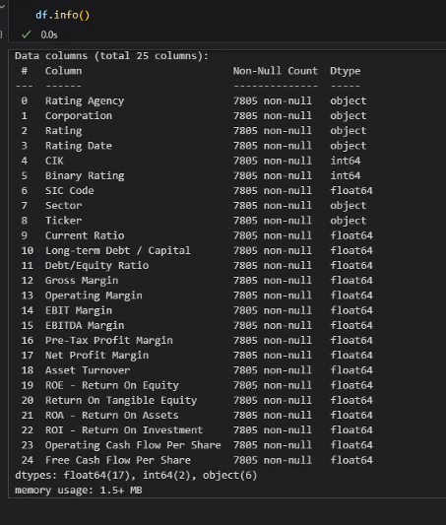
Original Columns:

Slide 5

Data Preparation
Loaded into database
Cleaned and processed data
Normalized Data removing outliers
Dropped features:
Corporation, Rating, CIK (Central Index Key), Ticker, SIC (Standard Industrial Classification) Code, Rating Date, Sector, Rating Agency
Class Imbalance
Attempted to over and under sample to address an imbalance in the data

Slide 6

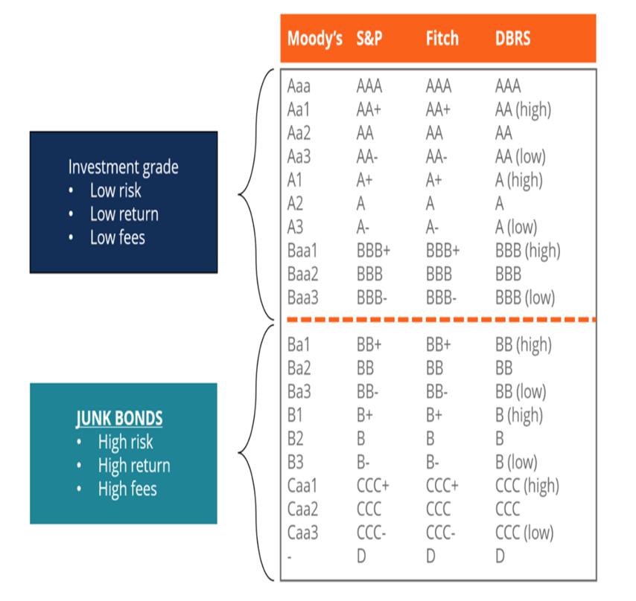
Ratings Explained
The original dataset included rating standardization:
Each agency has their own rating scales
All ratings have been aligned with the S&P rating scale
Binary Ratings were calculated in accordance with S&P’s classifications (1 for investment grade and 0 for junk grade)

Slide 7
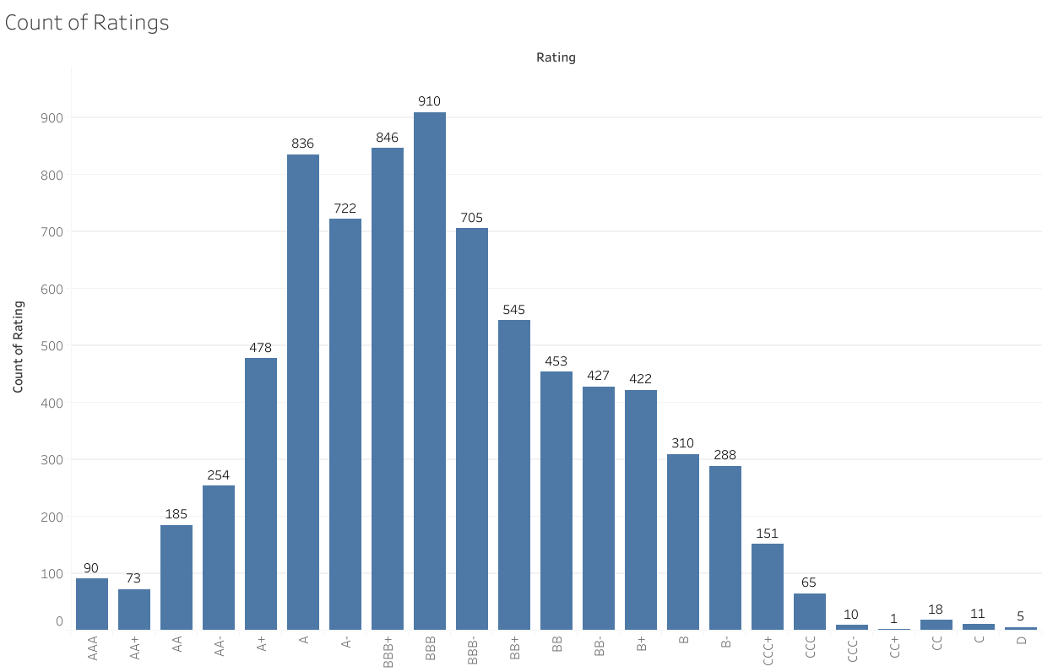
Distribution of Ratings by type
Notes:
What Is Standard & Poor's (S&P)?
Standard & Poor's (S&P) is a company well known around the world as a creator of financial market indices—widely used as investment benchmarks—a data source, and an issuer of credit ratings for companies and debt obligations. It's perhaps best-known for the popular and often-cited S&P 500 Index.

Slide 8
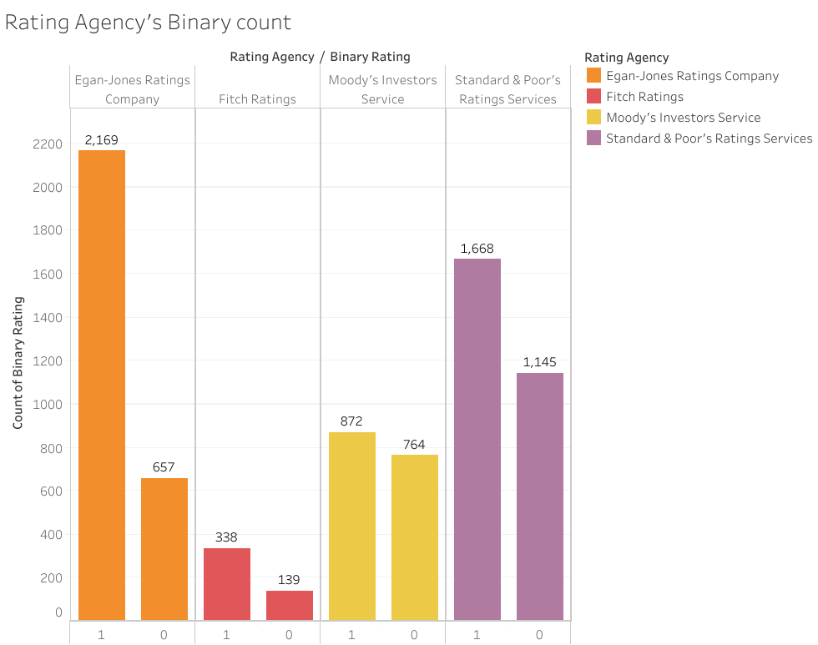
Ratings Distribution by Agency
These agencies have the most ratings in our data

Slide 9
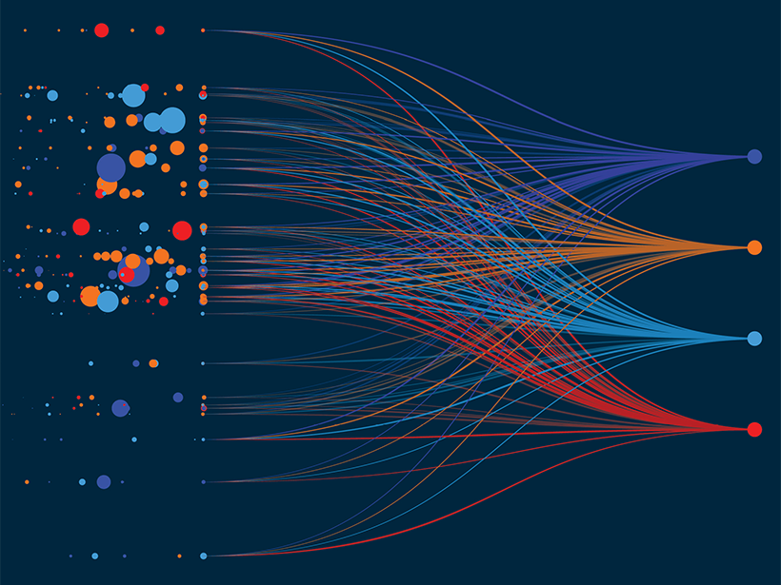
Deep Learning Model Overview
Model Design:
Hidden Layers: Tried various amounts with similar results
Activation Functions: Relu and Sigmoid
Activation Points: 75 activations gave best results
Neurons: Tried various amounts with similar results
Roadblocks
The deep learning models struggled to predict investor grade credit ratings
Deep learning is not always suited for smaller datasets especially with lots of variance and outliers
Decided to peruse other models

Slide 10
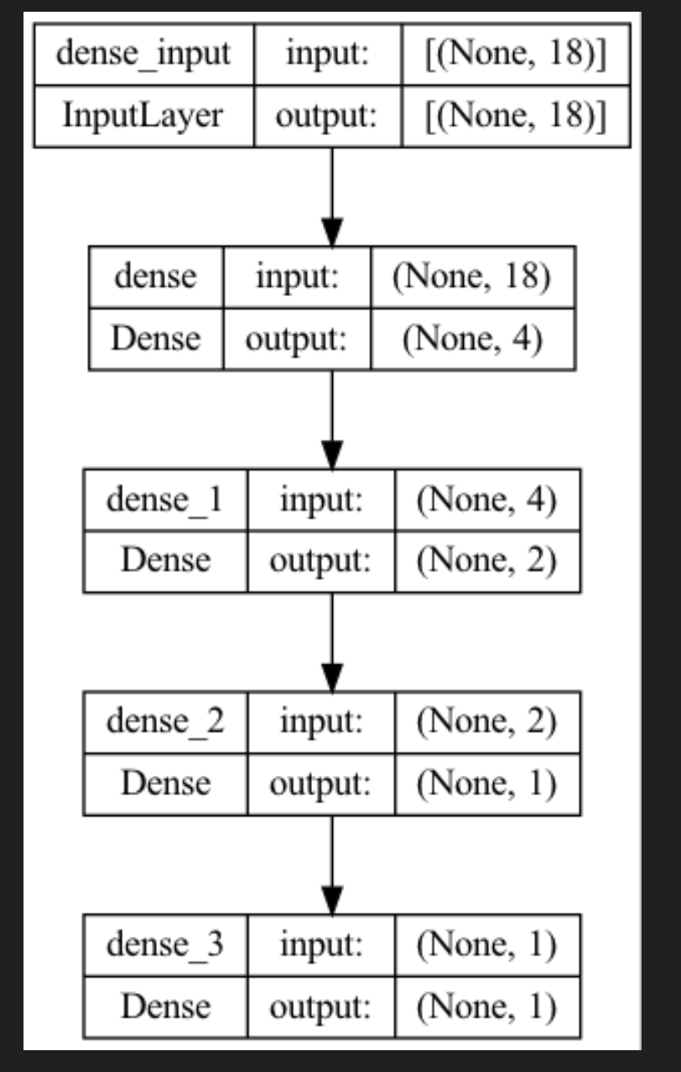
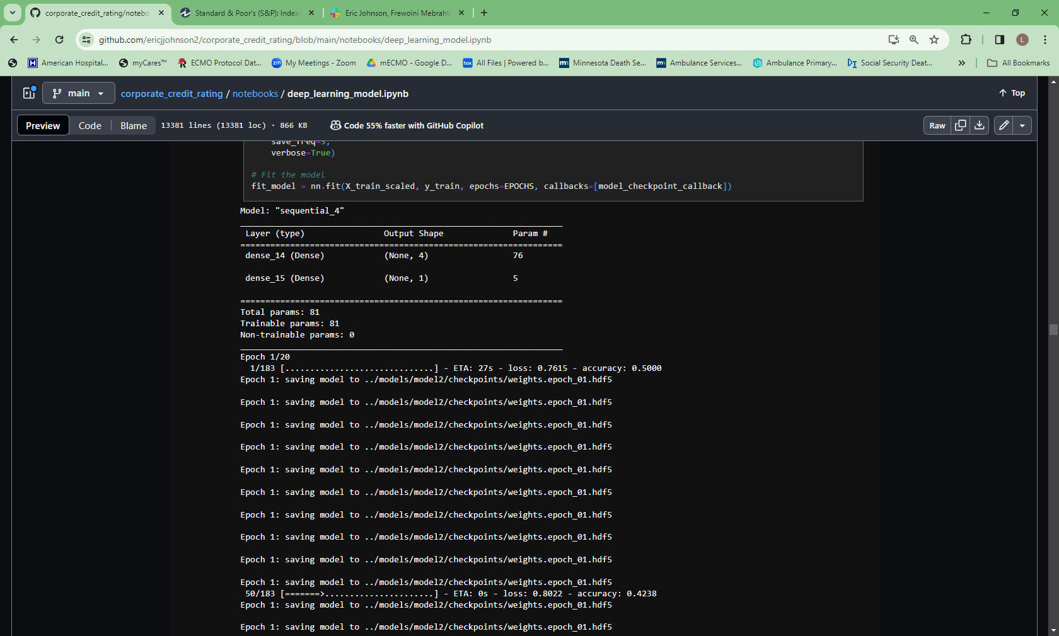
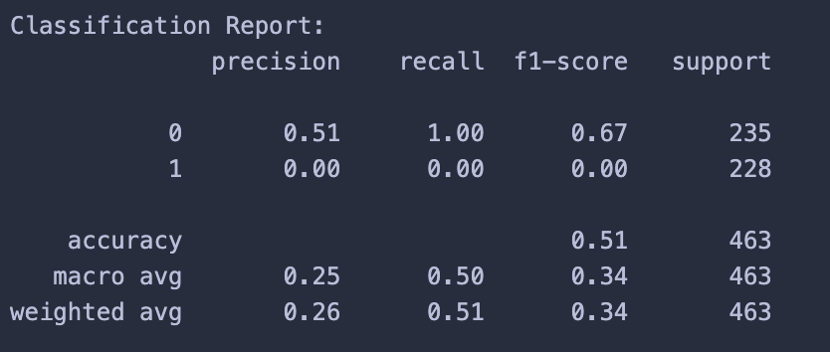
Deep Learning Model Design and Accuracy

Slide 11
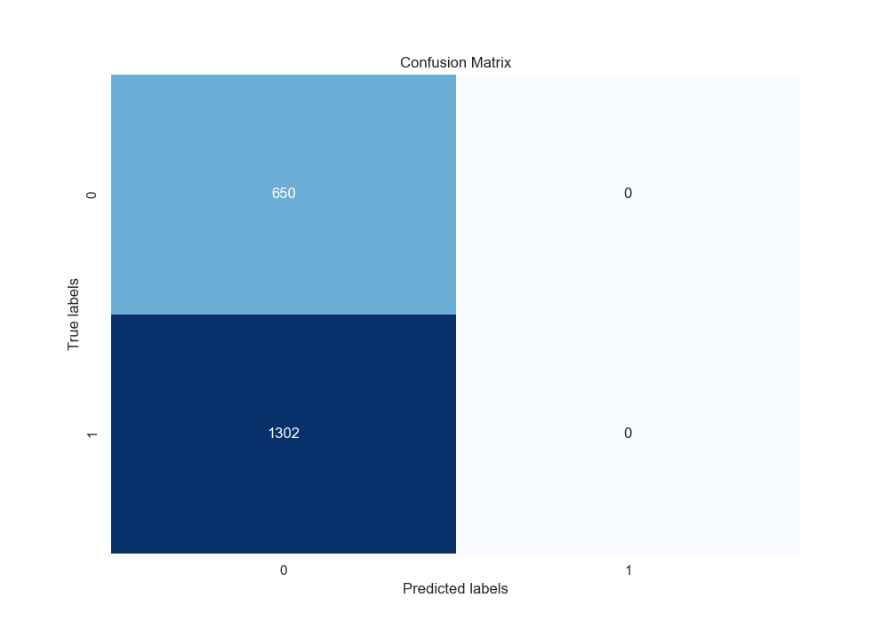
Deep Learning Model Confusion Matrix
Notes:
Missing positive predictions

Slide 12
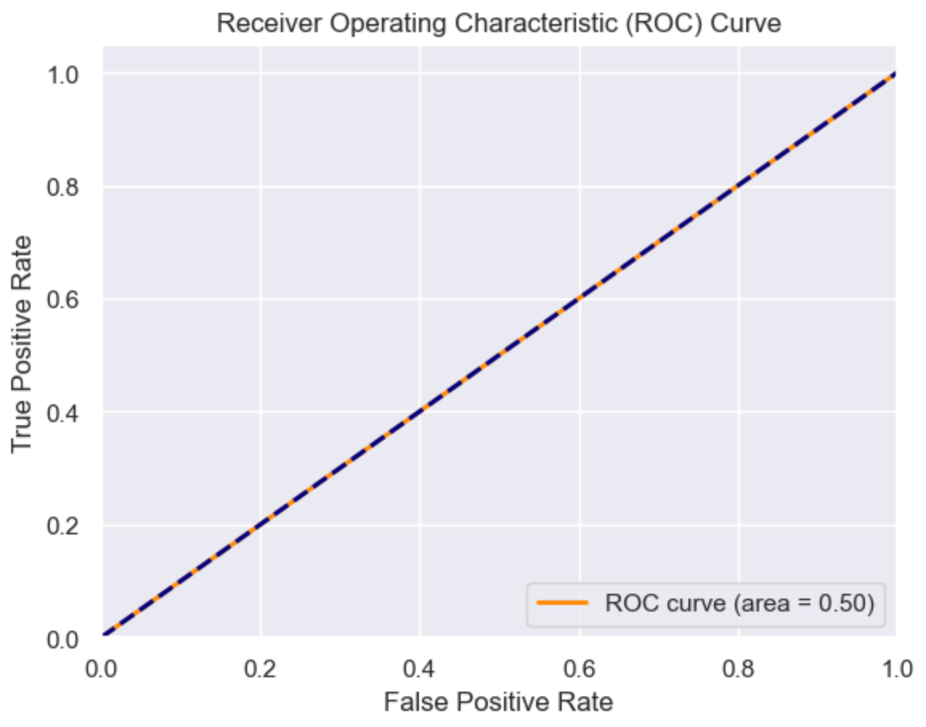
Deep Learning Model ROC Curve
Notes:
Another view of the missing positive predictions

Slide 13
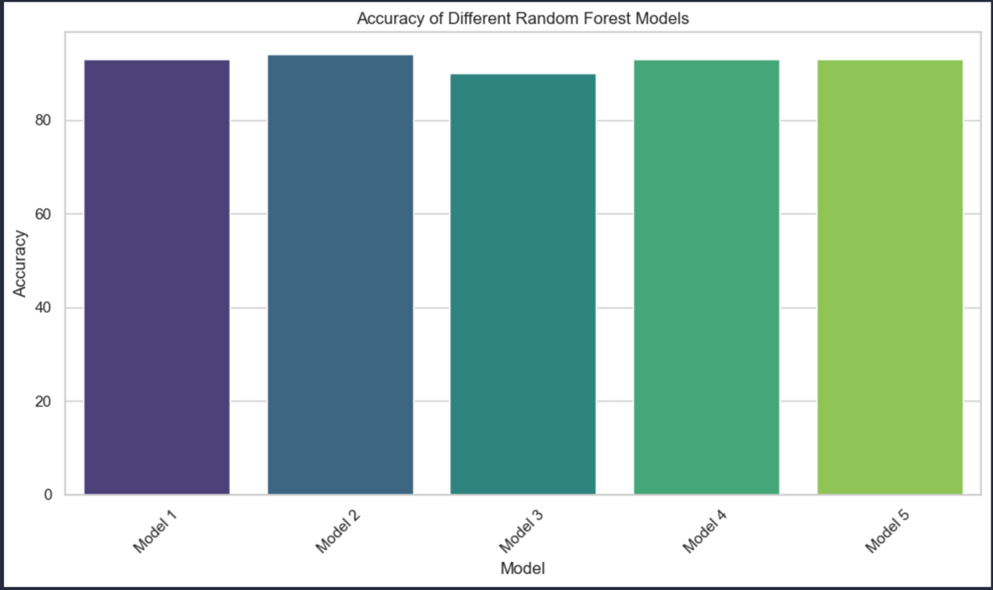
Random Forest Model
Model Design: 500 decision trees, Stratified K Folding (technique used to ensure models perform well even with class imbalance)
Accuracy: 94% accuracy

Slide 14
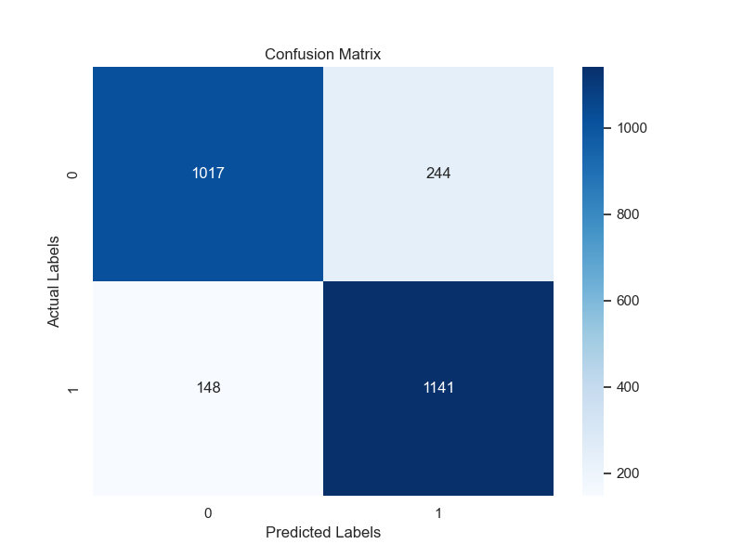
Random Forest Model Confusion Matrix

Slide 15
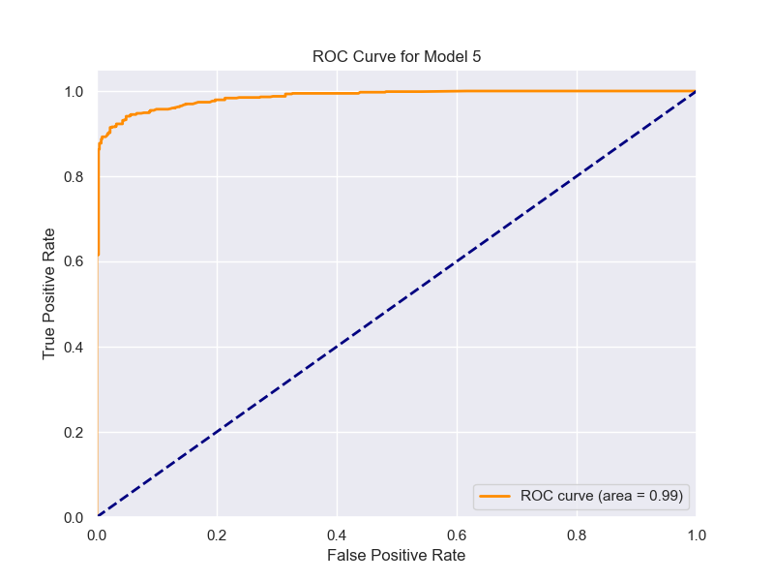
Random Forest Model ROC Curve (highly accurate)
Notes:
A ROC chart is like a report card for our model's performance, telling us how well the model does on accurate positive and negative predictions.

Slide 16
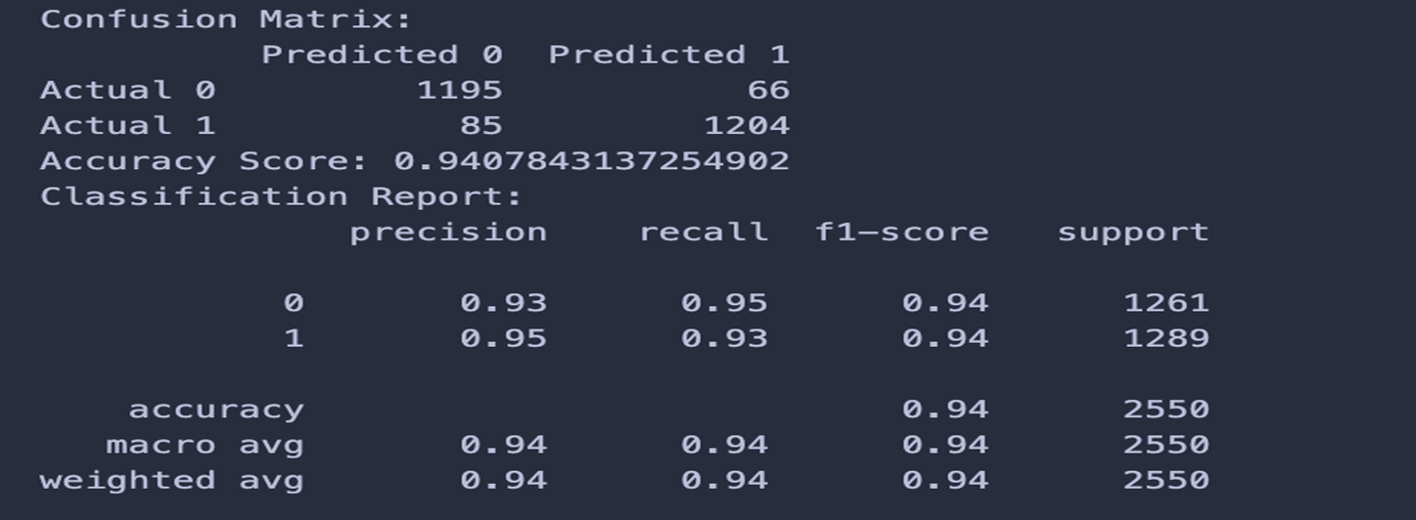
Random Forest Model Classification Report
Notes:
More details of models performance

Slide 17
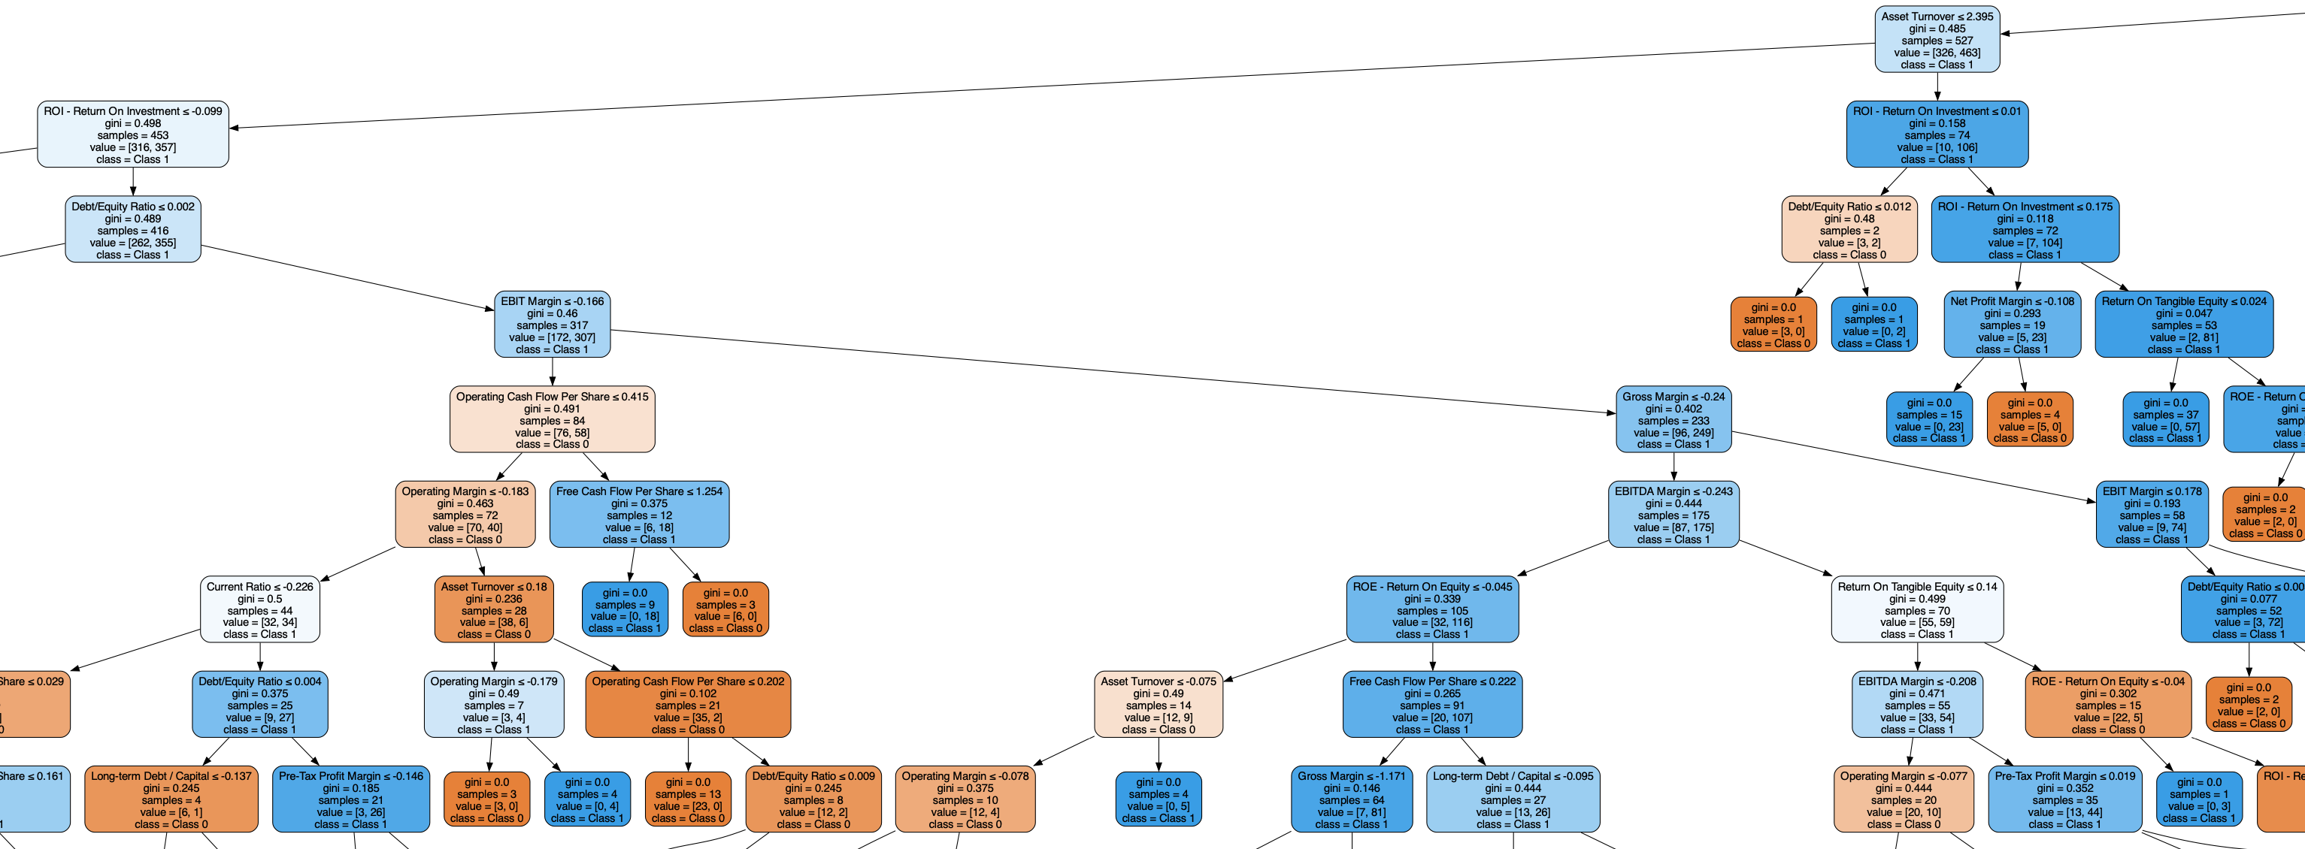
Random Forest Model A Snippet from a Decision Tree
Notes:
One small view of one of the 500 trees within the forest

Slide 18
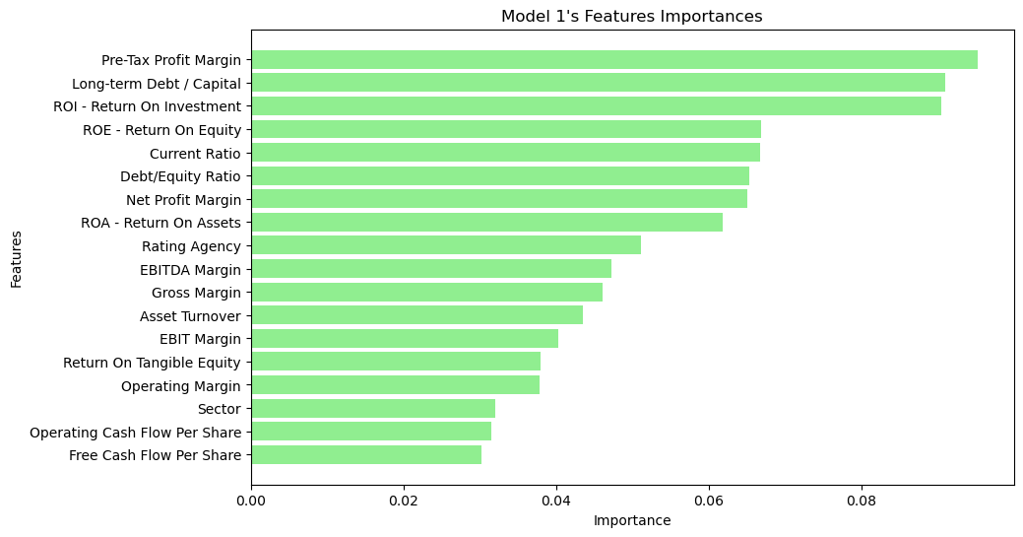
Random Forest Model Feature Importance
Notes:
In our winning model, the top three listed below were the most important features

Slide 19
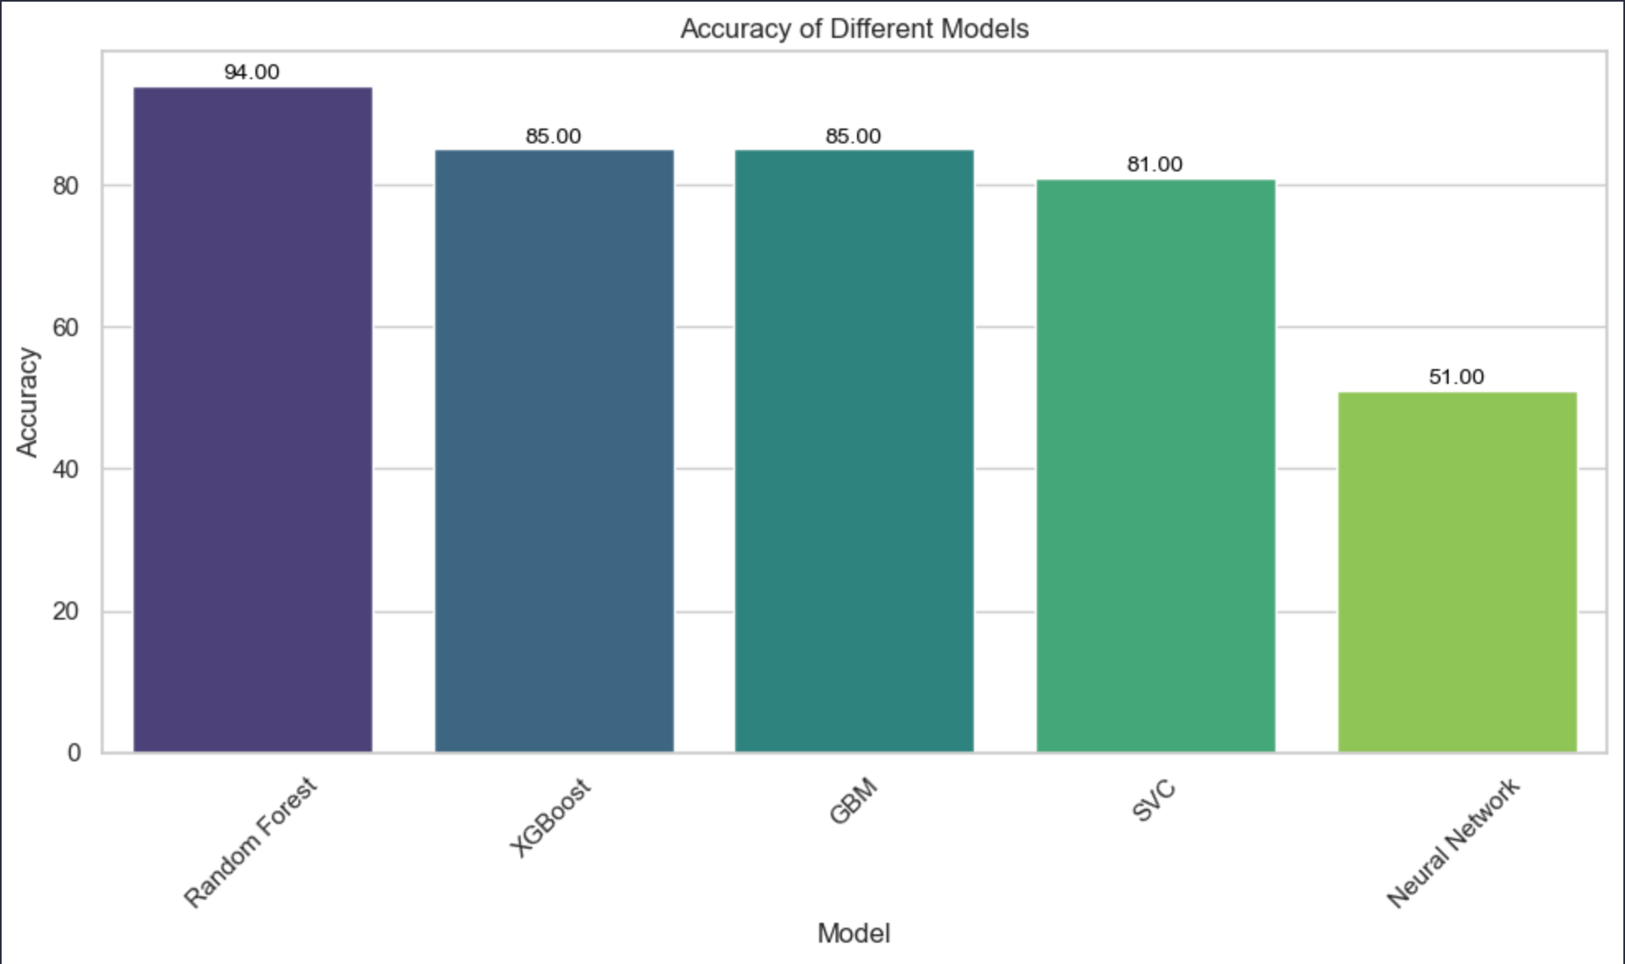
Machine Learning Models Accuracy Comparison
* Other models not discussed include XGBoost, SVC, and GBM models. These preformed better than the neural networks but less than the random forests.

Slide 20

Testing Model Performance with Alpha Vantage API
Accessed real world company data by pulling income statements, balance sheets, and cash flow statements to calculate features in the sample data
Formatted data alignment: Formatted the retrieved data to align with the structure of our sample data
Graphical Interface: Built an interface to assess the real-time data to test our trained models
Limitation: Some fields were not available for some companies. In those instances, averages were used in place of the missing values

Slide 21
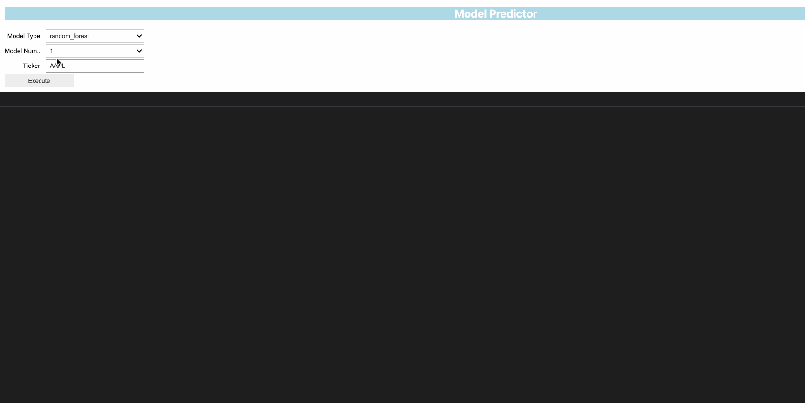
Testing Model Performance Interface demo

Slide 22

Conclusions
Encouraging Results: Machine learning has shown promising outcomes for this scenario.
Model Performance: Random forest models have been particularly successful, achieving a 94% accuracy rate.
Real-World Challenges: When applied to real-world situations, especially in predicting junk credit status, the models faced difficulties.
Improving Performance: Strategies such as k-folding and feature engineering were explored to enhance model performance.
Industry Sector Impact: Industry sector information improved prediction accuracy but was not available in our API. Future improvements could be realized by incorporating a second API.

Slide 23
References
"Designing Machine Learning Systems" by Chip Huyen - O'Reilly Press
"Practical Statistics for Data Scientists" by Peter Bruce, Andrew Bruce, & Peter Gedeck - O'Reilly Press
Data Source: https://www.kaggle.com/datasets/kirtandelwadia/corporate-credit-rating-with-financial-ratios
https://www.alphavantage.co/documentation/
https://stackoverflow.com/questions/36814100/pandas-to-numeric-for-multiple-columns
https://scikit-learn.org/stable/modules/generated/sklearn.model_selection.StratifiedKFold.html#sklearn-model-selection-stratifiedkfold
https://www.geeksforgeeks.org/stratified-k-fold-cross-validation/
https://towardsdatascience.com/what-is-stratified-cross-validation-in-machine-learning-8844f3e7ae8e
https://github.com/mwaskom/seaborn/issues/3478
https://ipywidgets.readthedocs.io/en/latest/examples/Widget%20List.html
https://stockanalysis.com/pro/the-barbell-investor/
https://matplotlib.org/stable/gallery/color/named_colors.html
https://scikit-learn.org/stable/modules/generated/sklearn.ensemble.RandomForestClassifier.html
https://stackoverflow.com/questions/51921142/how-to-load-a-model-saved-in-joblib-file-from-google-cloud-storage-bucket
https://stackoverflow.com/questions/9622163/save-plot-to-image-file-instead-of-displaying-it
https://www.datacamp.com/tutorial/random-forests-classifier-python
https://keras.io/api/keras_tuner/hyperparameters/
https://pytorch.org/docs/stable/generated/torch.nn.ReLU6.html
https://seekingalpha.com/article/4679188-junk-bond-default-surge-continues-in-2024
https://pypi.org/project/imbalanced-learn/
https://www.youtube.com/watch?v=YUsx5ZNlYWc
https://www.youtube.com/watch?v=VtchVpoSdoQ&t=582s
https://stackoverflow.com/questions/25009284/how-to-plot-roc-curve-in-python
https://www.investopedia.com/terms/c/currentratio.asp
https://www.investopedia.com/terms/l/longtermdebt-capitalization.asp
https://www.investopedia.com/terms/d/debtequityratio.asp
https://www.investopedia.com/terms/g/grossmargin.asp
https://www.omnicalculator.com/finance/margin#gross-margin-formula
https://www.investopedia.com/terms/o/operatingmargin.asp
https://www.investopedia.com/terms/e/ebit.asp
https://www.investopedia.com/terms/e/ebitda-margin.asp
https://www.investopedia.com/terms/p/pretax-margin.asp
https://www.investopedia.com/terms/n/net_margin.asp
https://www.investopedia.com/terms/r/returnonequity.asp
https://www.wallstreetprep.com/knowledge/return-on-tangible-equity-rote/
https://www.investopedia.com/terms/r/returnonassets.asp
https://www.wallstreetprep.com/knowledge/return-on-equity-roe/
https://www.investopedia.com/terms/r/returnoninvestment.asp
https://www.investopedia.com/terms/c/cashflowpershare.asp
https://www.wallstreetprep.com/knowledge/cash-flow-per-share/
https://www.investopedia.com/terms/f/freecashflowpershare.asp

Slide 24


Thank you. Questions?

